Slide 1
Using Single Sign-On (SSO) with Office Add-ins
Implement Single Sign-On (SSO) for Office Add-ins

Slide 2

Implement Single Sign-On (SSO) for Office Add-ins-
Authentication & authorization with Office Add-ins
Office Add-ins & Single Sign-On (SSO)
Understanding the SSO flow
Implementing SSO in Office Add-ins

Slide 3
Office Add-ins and Single Sign-on (SSO)
Office Add-in SSO support added to Office clients in 2020
Office web clients
Office Windows clients v16.0.12215.2006 (or higher)
Office macOS clients v16.32.19102902 (or higher)
Reduces how often users are prompted to login to third-party services
Implemented using:
Azure AD application
Office JavaScript SDK
Client-side code in the Office Add-in

Slide 4
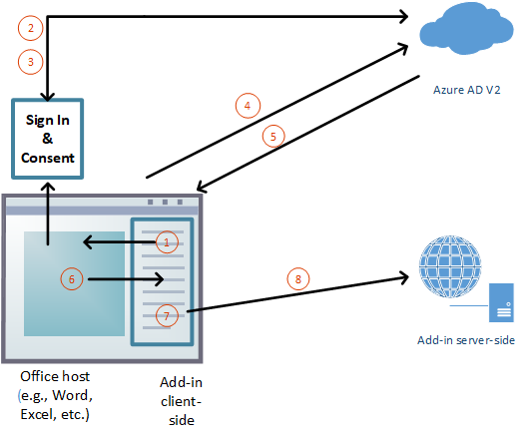
Understand the SSO authentication flow
Notes:
1. In the add-in, JavaScript calls a new Office.js API: `getAccessToken()`. This tells the Office client application to obtain an access token to the add-in.
2. If the user isn't signed in, the Office client application opens a pop-up window for the user to sign in.
3. If this is the first time the current user has used your add-in, they're prompted to consent.
4. The Office client application requests the add-in token from the Azure AD v2.0 endpoint for the current user.
5. Azure AD sends the add-in token to the Office client application.
6. The Office client application sends the add-in token to the add-in as part of the result object returned by the `getAccessToken()` call.
7. JavaScript in the add-in can parse the token and extract the information it needs, such as the user's email address.
8. Optionally, the add-in can send HTTP request to it's server-side for more data about the user; such as the user's preferences. Instead, the access token itself could be sent to the server-side for parsing and validation there.

Slide 5
Register the Azure AD application

Slide 6
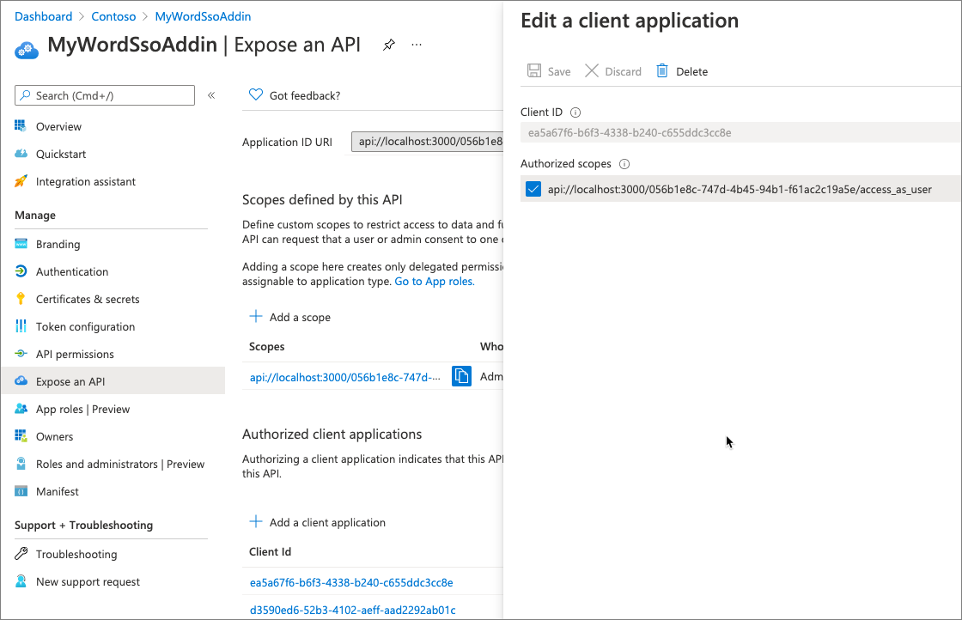
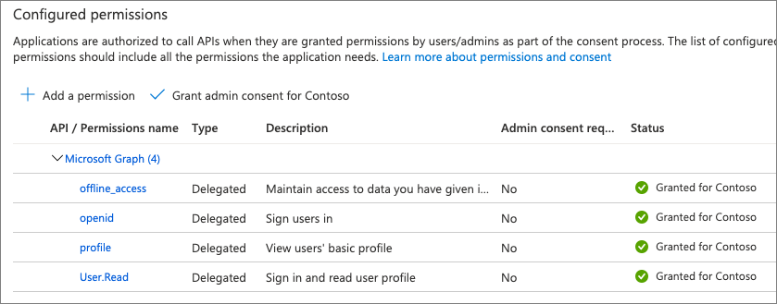

Slide 7
Associate the Office Add-in with the Azure AD application
Link the add-in to the Azure AD app in the manifest.xml
Sample create an App component with title property
Id: Azure AD application’s [client] ID
Resource: URI of the add-in as listed in the Azure AD app registration
Scopes: list of permissions granted to the Azure AD app
Note: All add-ins require the profile & openid scopes
<WebApplicationInfo>
<Id>056b1e8c-747d-4b45-94b1-f61ac2c19a5e</Id>
<Resource>api://localhost:3000/056b1e8c-747d-4b45-94b1-f61ac2c19a5e</Resource>
<Scopes>
<Scope>User.Read</Scope>
<Scope>profile</Scope>
<Scope>openid</Scope>
</Scopes>
</WebApplicationInfo>

Slide 8
Implement the client-side code
let bootstrapToken =
await OfficeRuntime.auth.getAccessToken(
{
allowSignInPrompt: true
});
// returned token commonly referred to as `bootstrap token`
// includes user’s name, preferred_name, oid, & tid
//
// token scope set to `access_as_user`

Slide 9
Demo

Slide 10

Summary
Authentication & authorization with Office Add-ins
Office Add-ins & Single Sign-On (SSO)
Understanding the SSO flow
Implementing SSO in Office Add-ins

Slide 11
Reading further
Office Add-ins documentation
https://docs.microsoft.com/office/dev/add-ins/
Overview of authentication & authorization in Office Add-ins
https://docs.microsoft.com/office/dev/add-ins/develop/overview-authn-authz
Enabling single sign-on for Office Add-ins
https://docs.microsoft.com/office/dev/add-ins/develop/sso-in-office-add-ins
Authorize to Microsoft Graph with SSO
https://docs.microsoft.com/office/dev/add-ins/develop/authorize-to-microsoft-graph

Slide 12
Thank you

